Slide 1
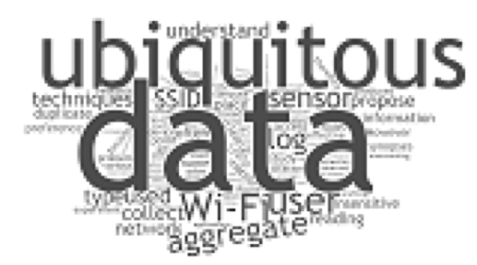
高等資料探勘與巨量資料處理
Introduction to Probability-based Classification

Slide 2
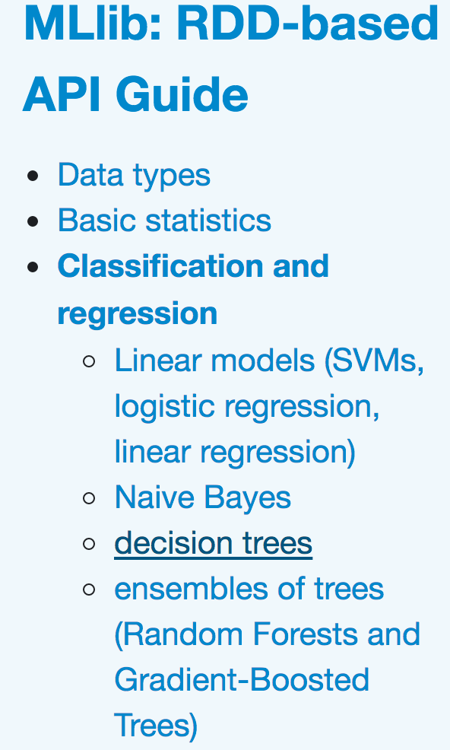
Probability-based Learning
• Information-based Learning
• Similarity-based Learning
• Error-based Learning
• Probability-based Learning

Slide 3

故事是這樣的...

Slide 4
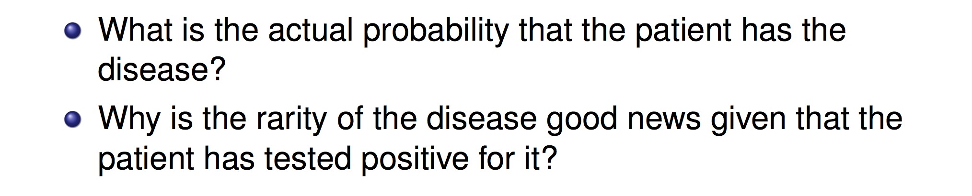
Bayesian Viewpoint for Prediction
After a yearly checkup, a doctor informs you that he has both bad news and good news.
The bad news is that (1) you have tested positive for a serious disease and (2) the test is 99% accurate.
The good news is that the disease is extremely rare, striking only 1 in 10,000 people.
My Question:

Slide 5
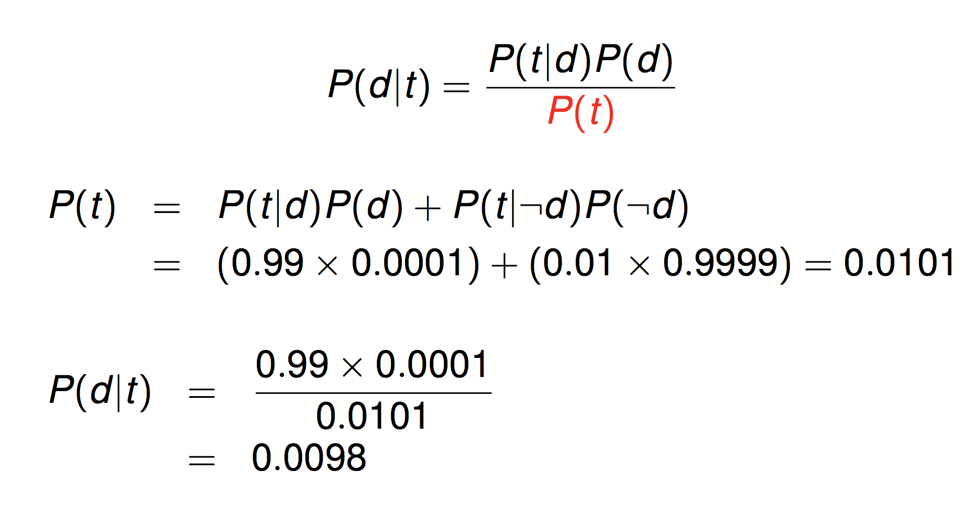
Bayesian Viewpoint for Prediction
t: test positive
Q₁ : Can I call the test is useless ?
Q₂ : 流感快篩在流感季節比較準？

Slide 6


Slide 7
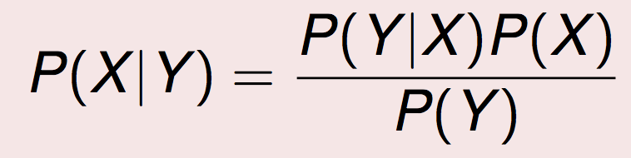
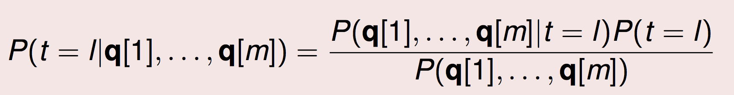
Bayes’ Theorem can be employed for Classification!
Bayes Theorem:
Prediction, e.g., sick or not
feature, e,g, 表徵、檢測

Slide 8
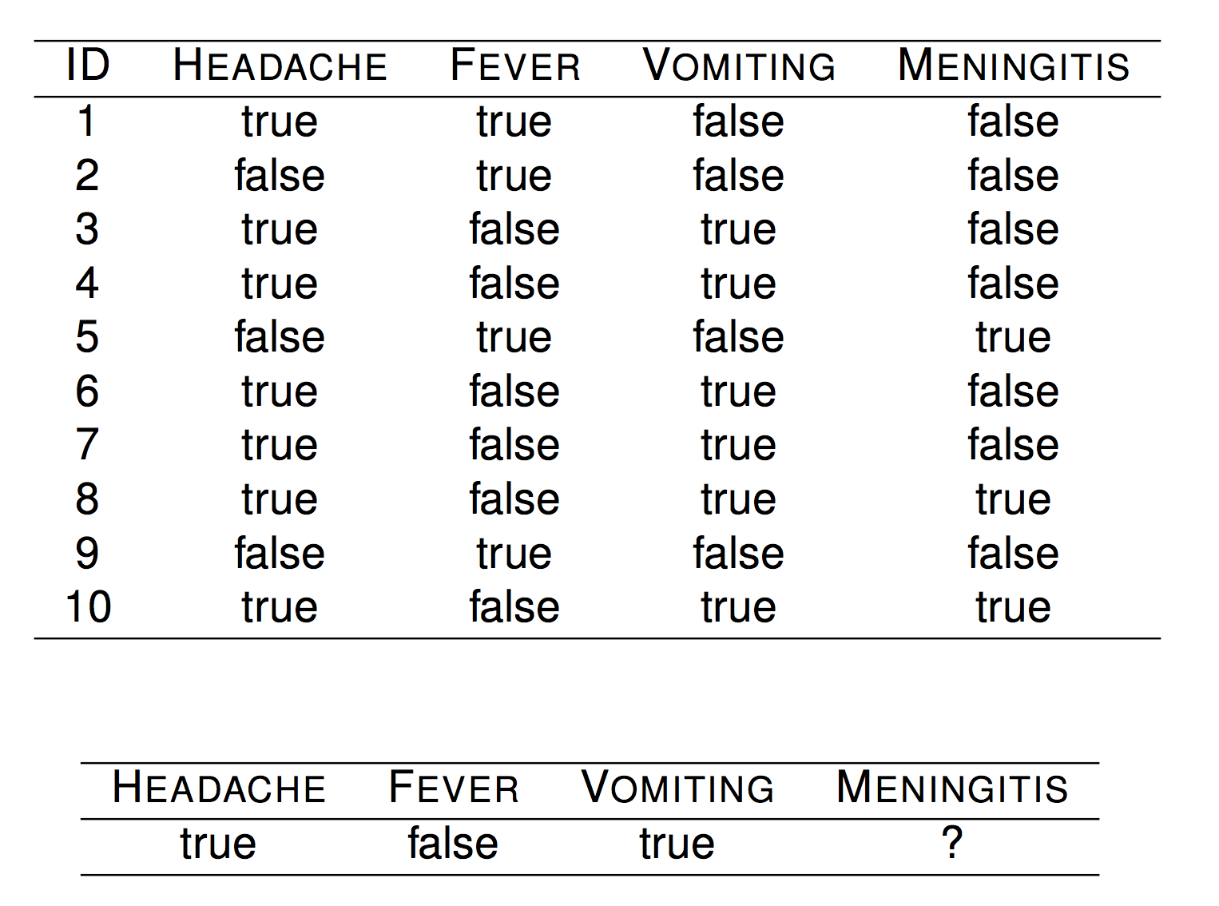
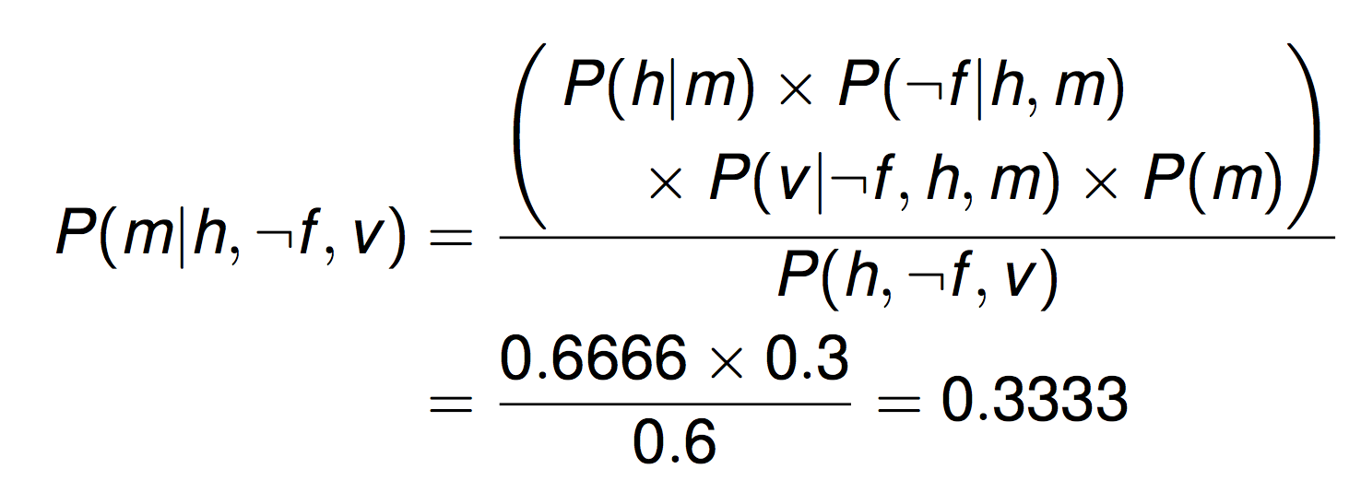
Bayesian Viewpoint

Slide 9
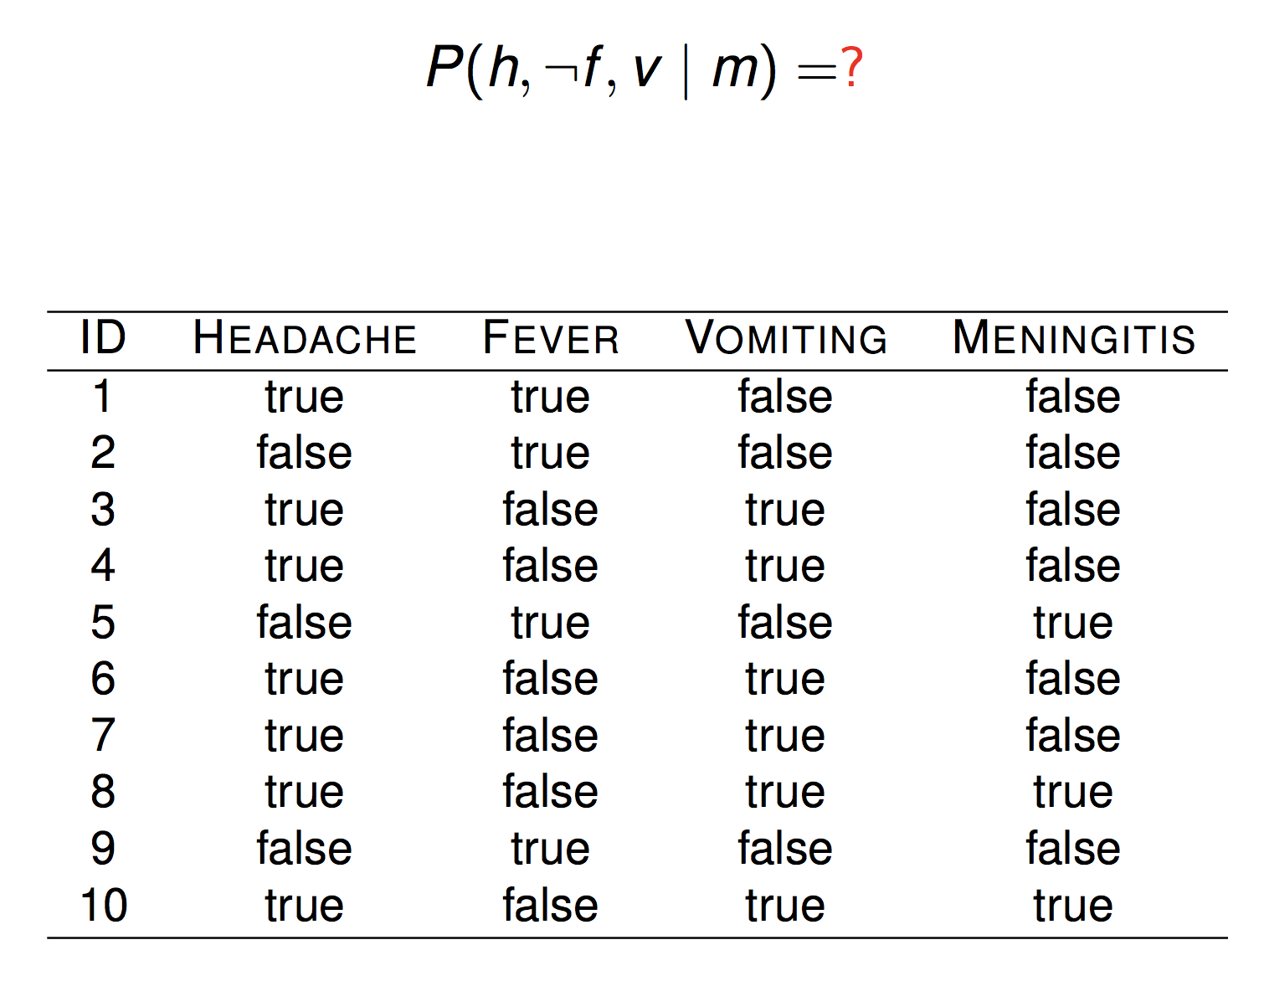
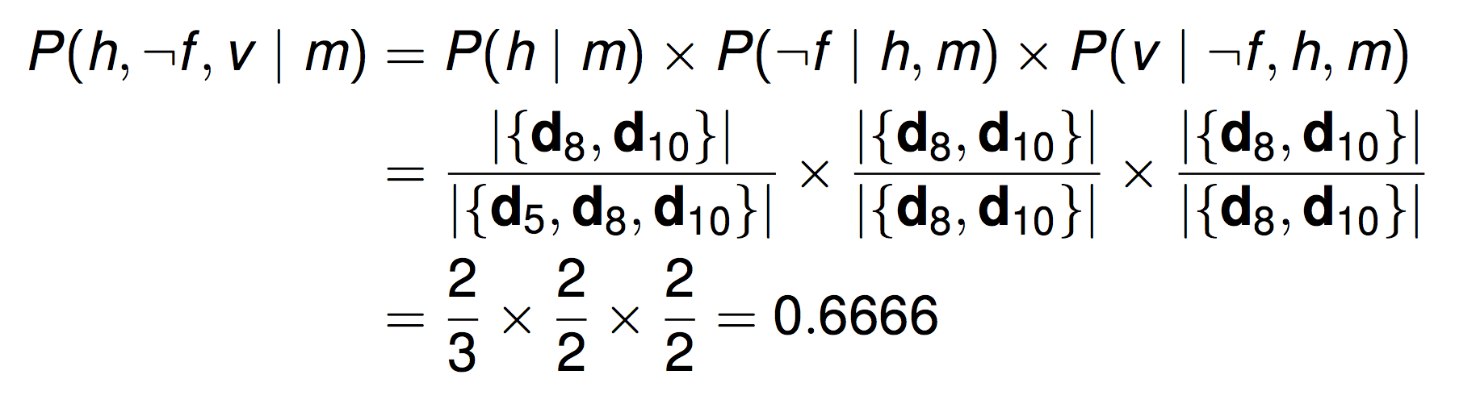

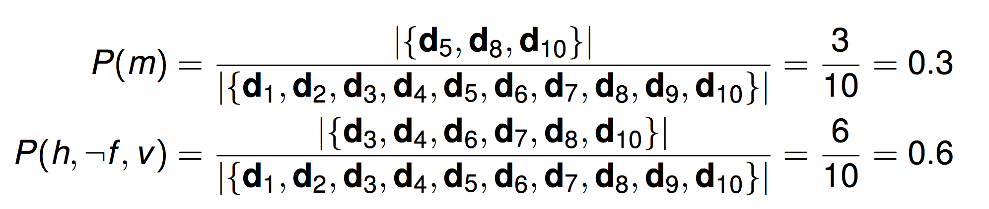

Slide 10
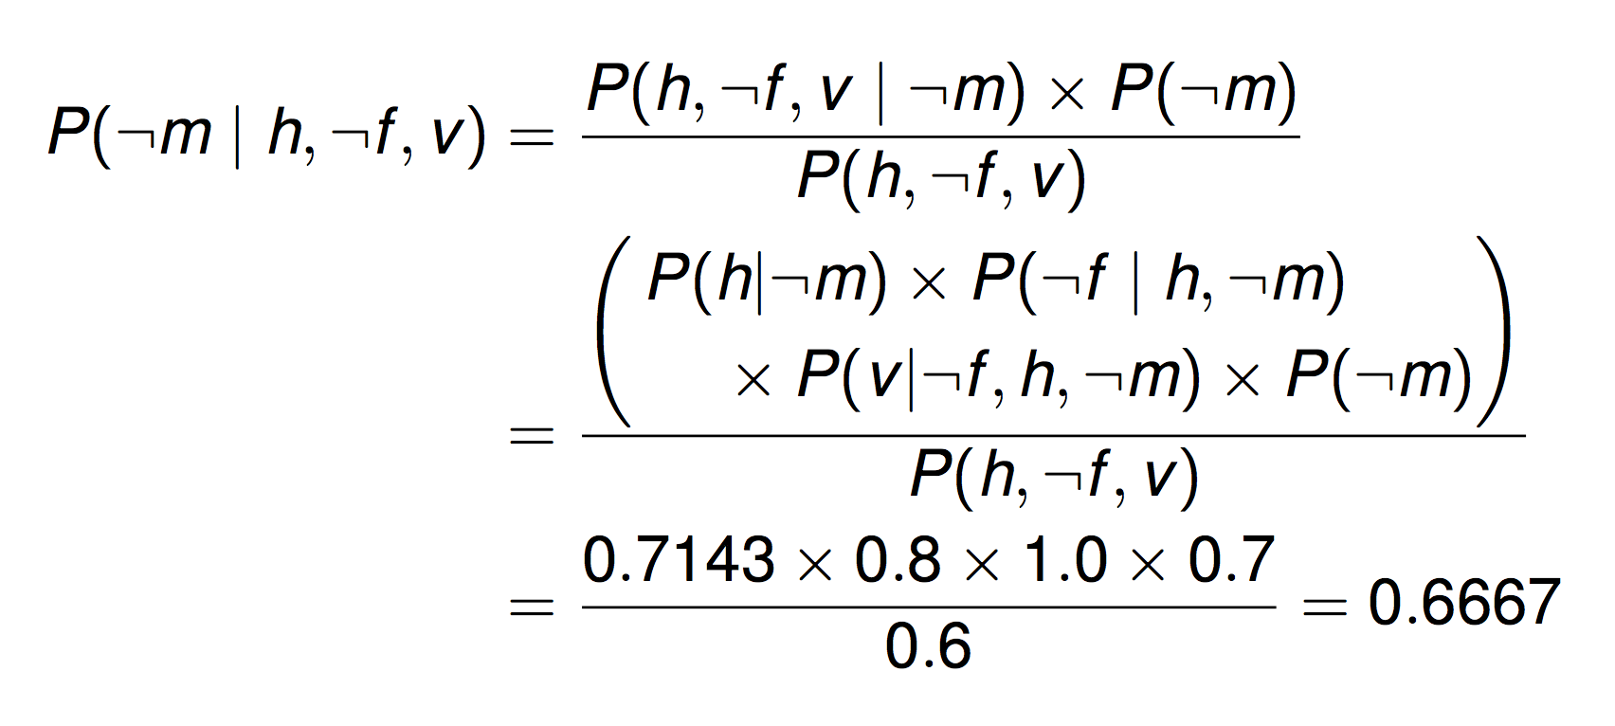

Your Turn

Slide 11
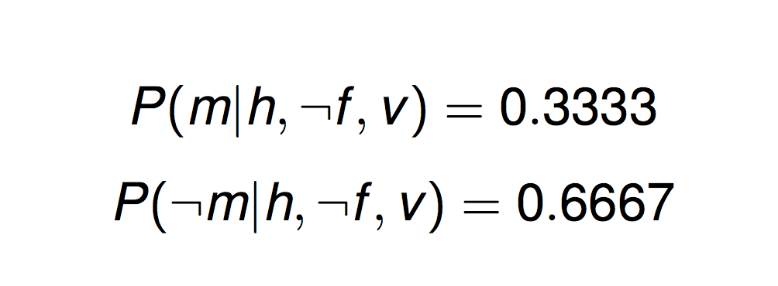
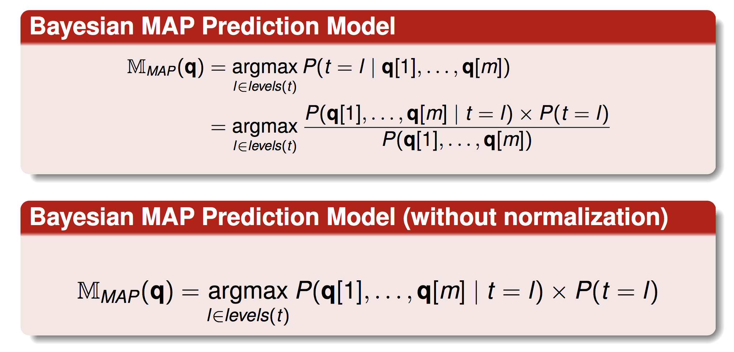
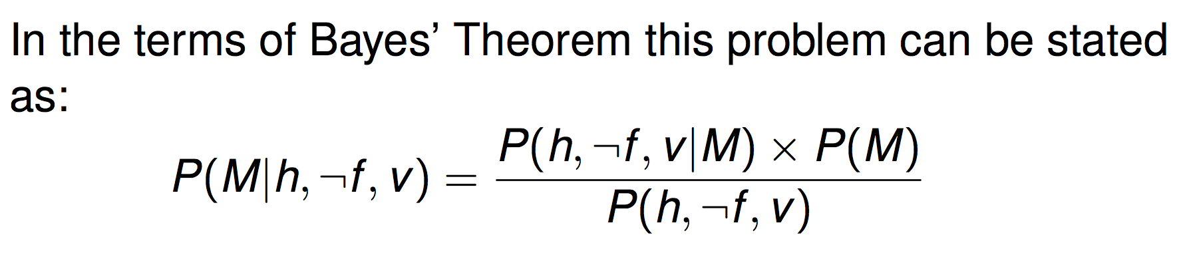

Slide 12
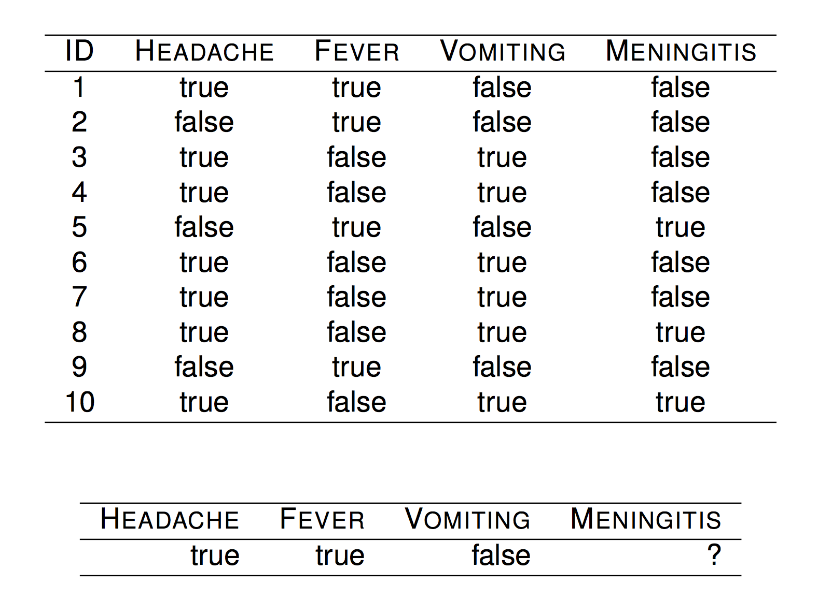
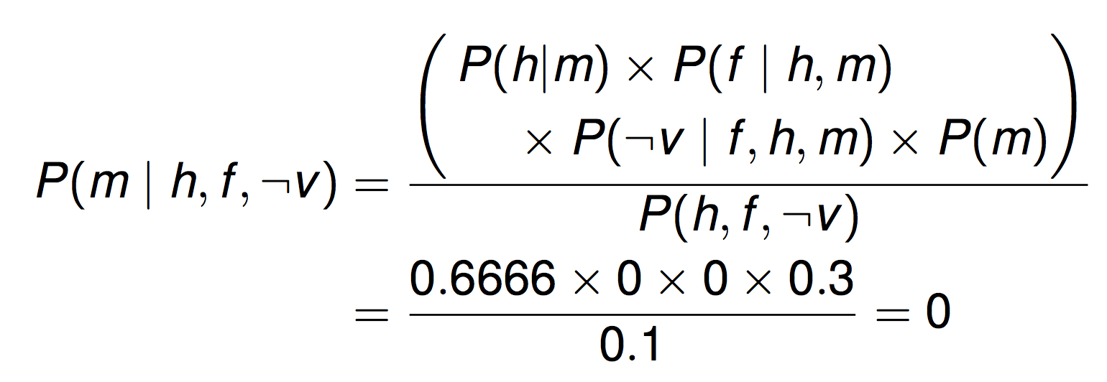
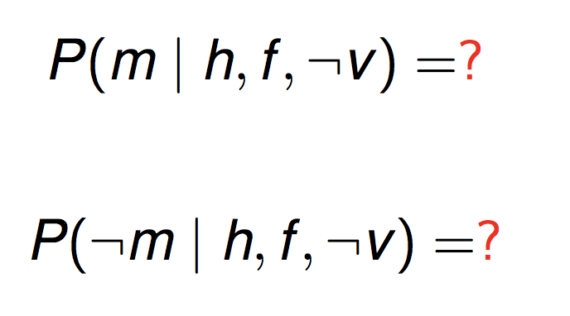
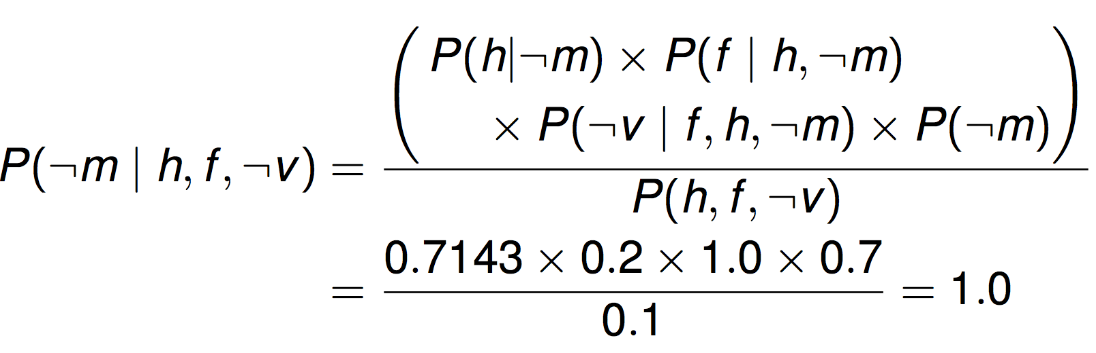

Slide 13
Problem:
Training data is always not enough for
bayesian classification model
Always !!!!!!!!!!!!!!!!

Slide 14
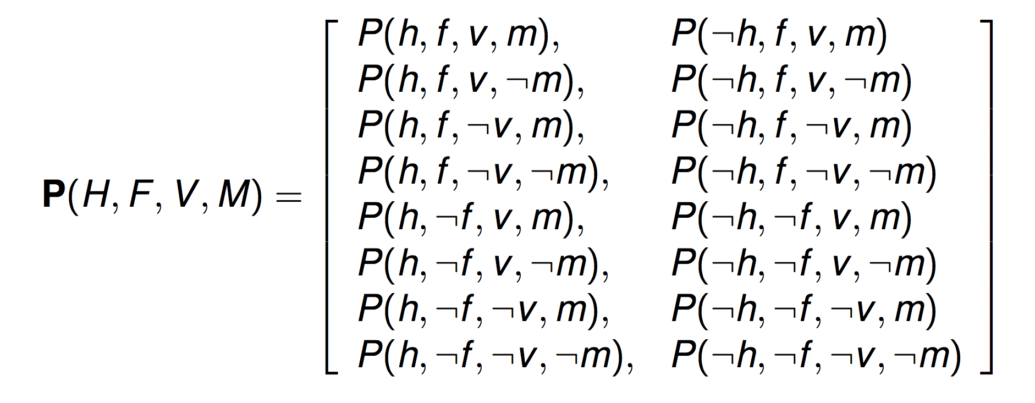
Do you observe the problem ?
10 v.s. 2⁴ ?

Slide 15
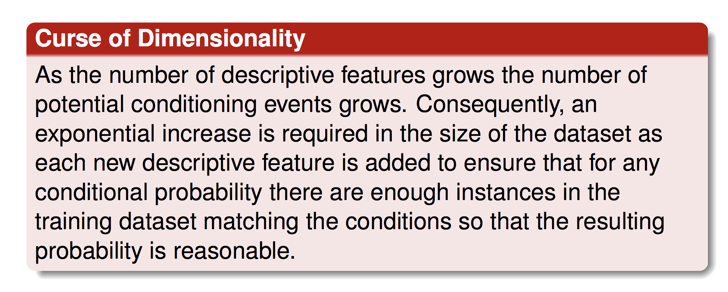

Slide 16
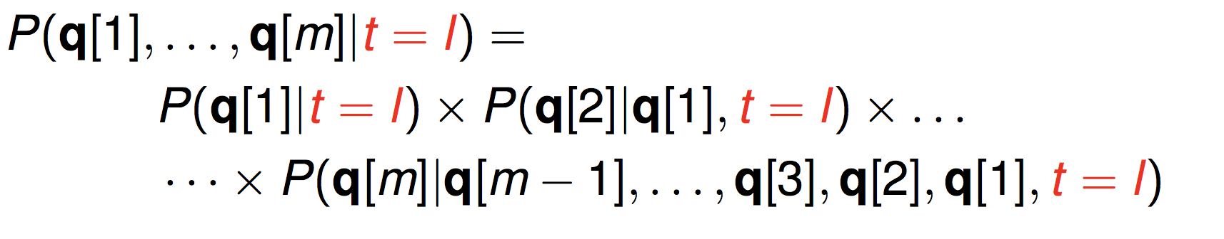
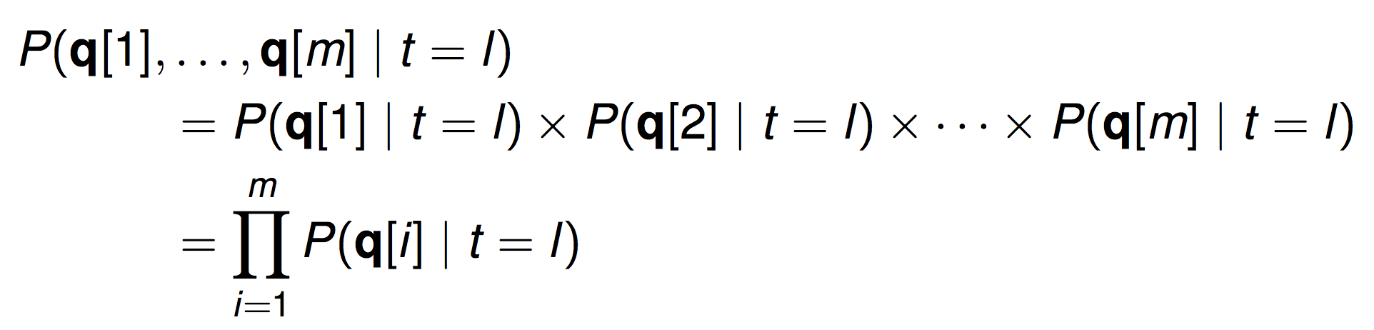
Assume the features are independent !

Slide 17
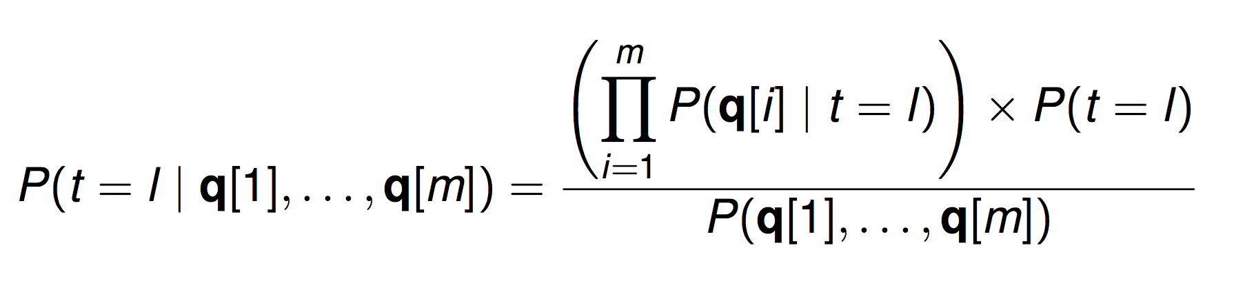
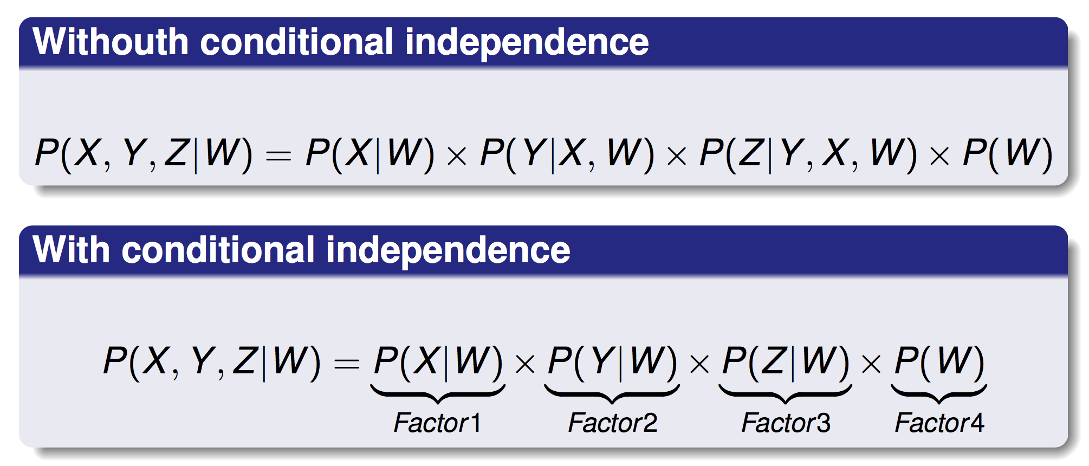

Slide 18
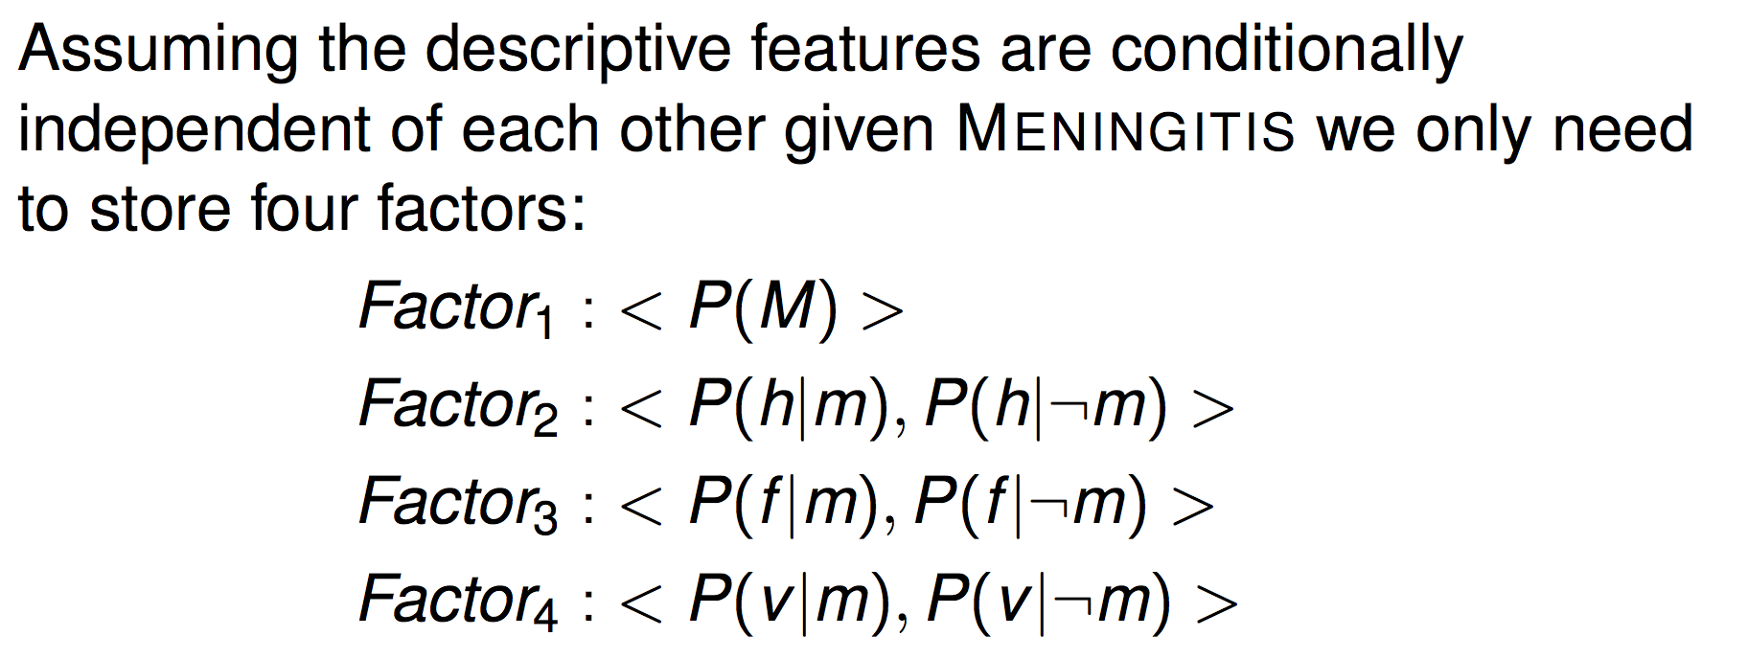
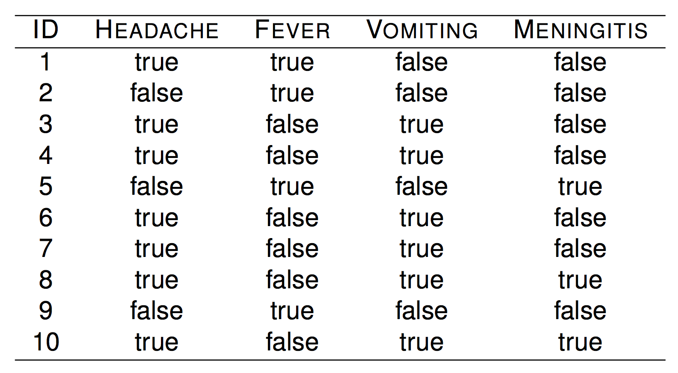
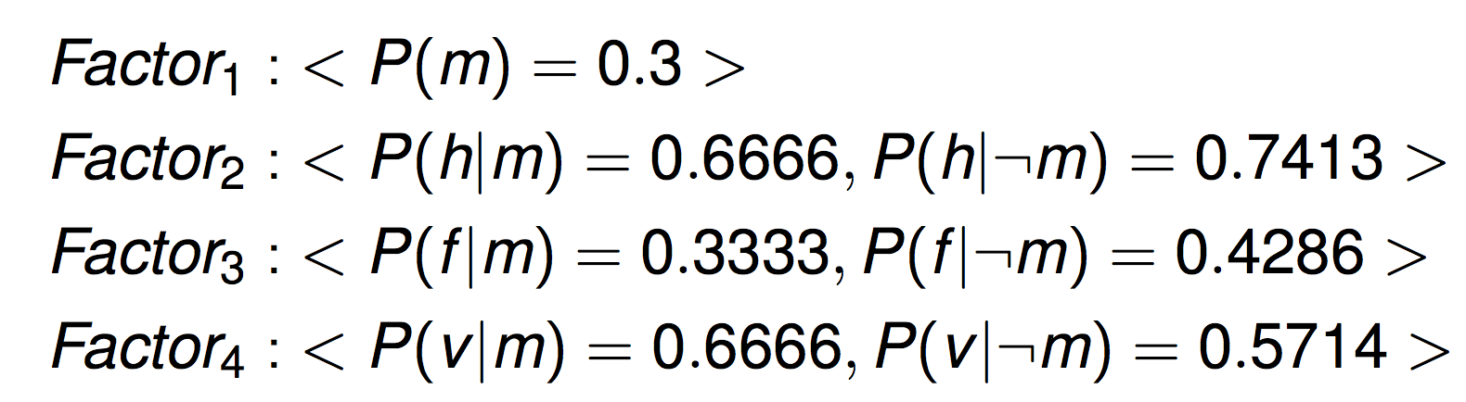

Slide 19
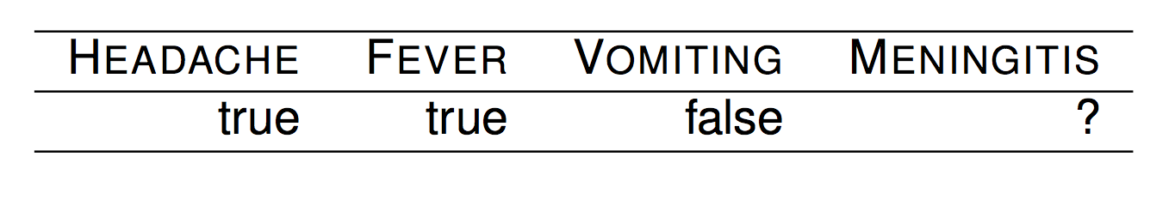
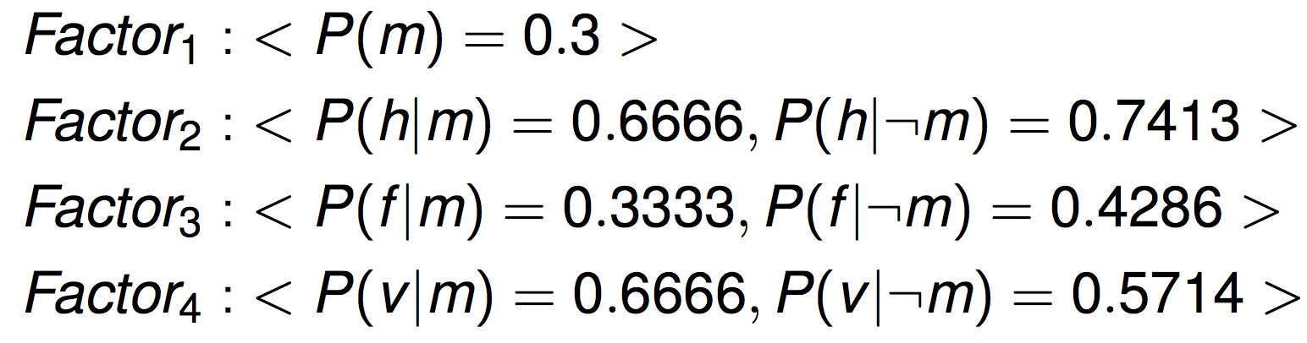
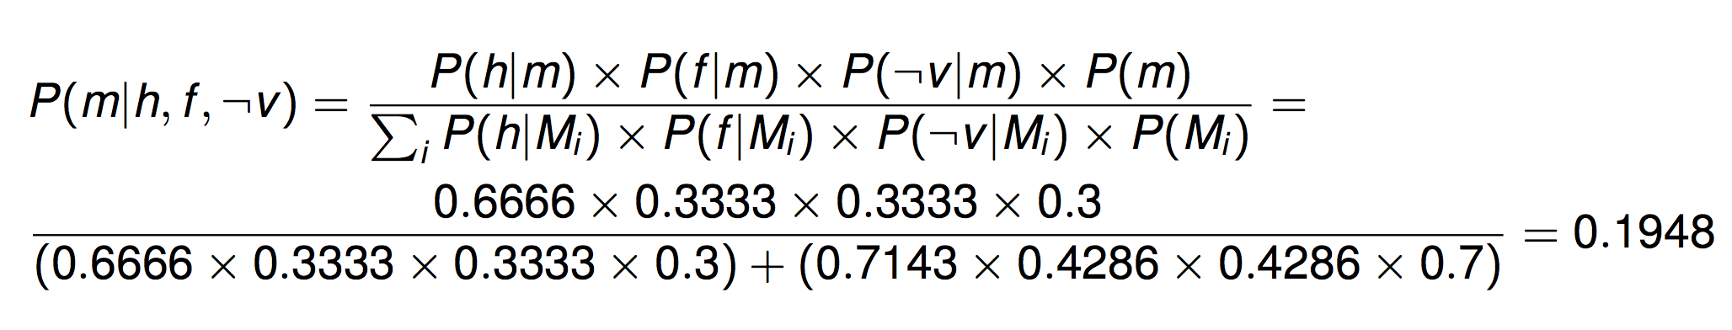
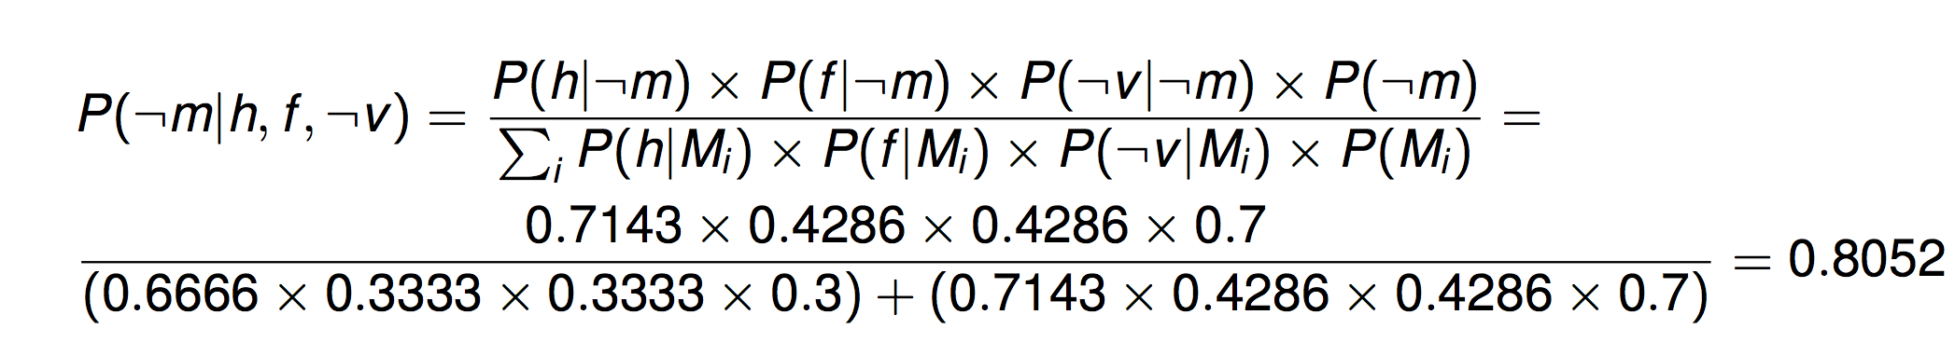

Slide 20
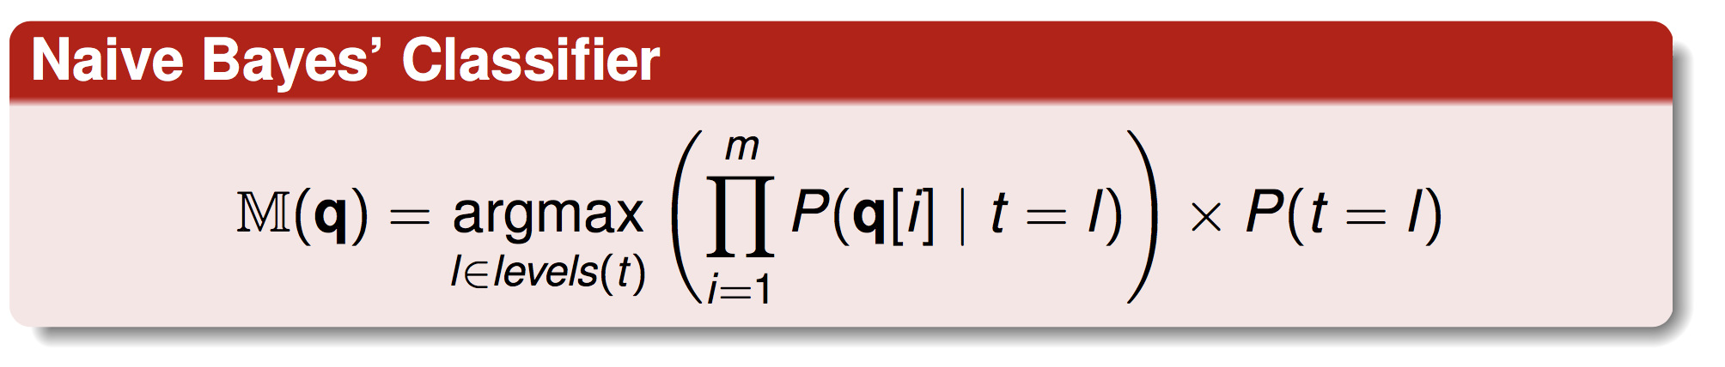
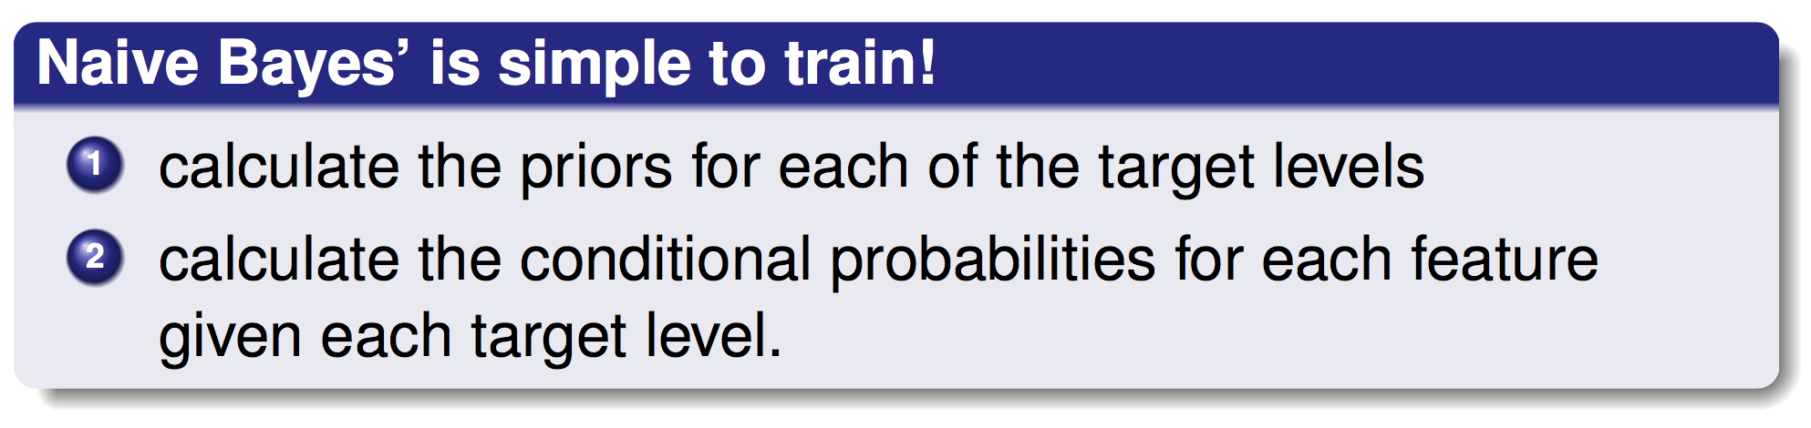
So, We have Naive Bayes’ Classifier as follows

Slide 21
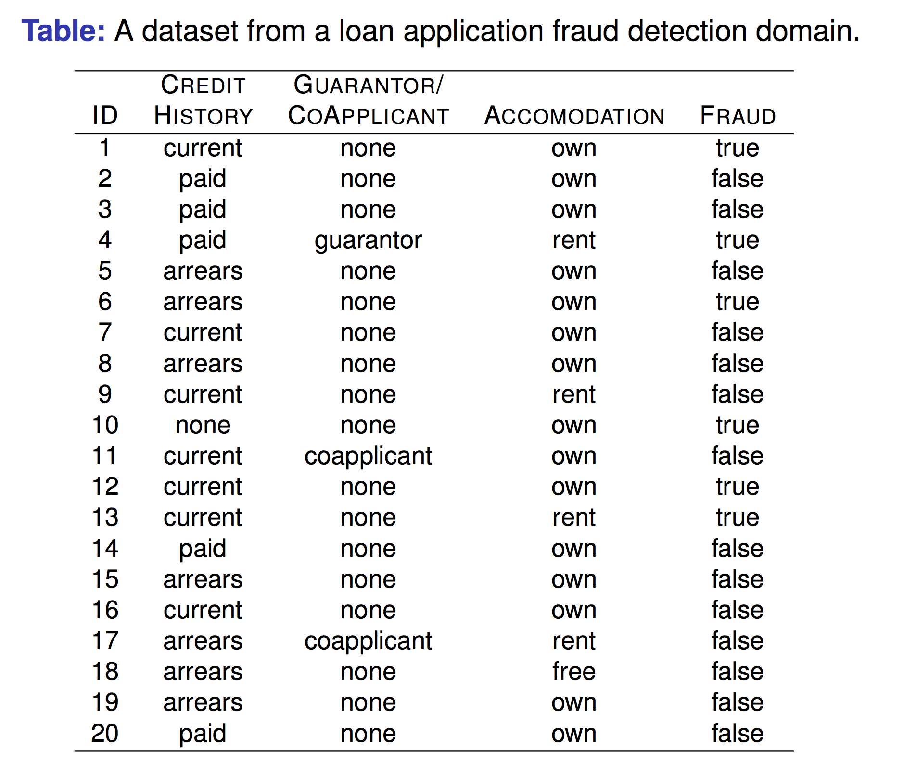

Slide 22
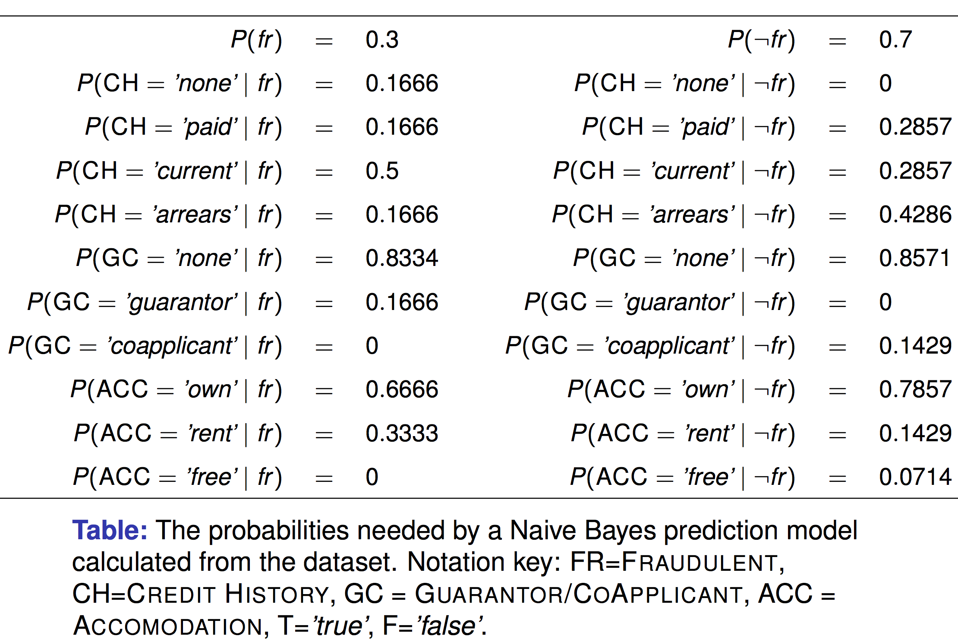

Slide 23
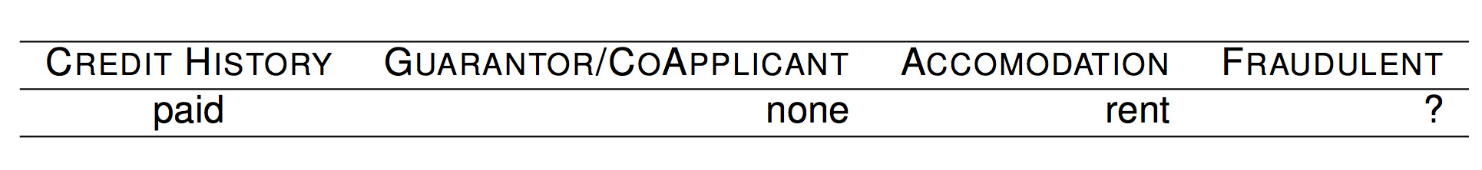
Given

Slide 24
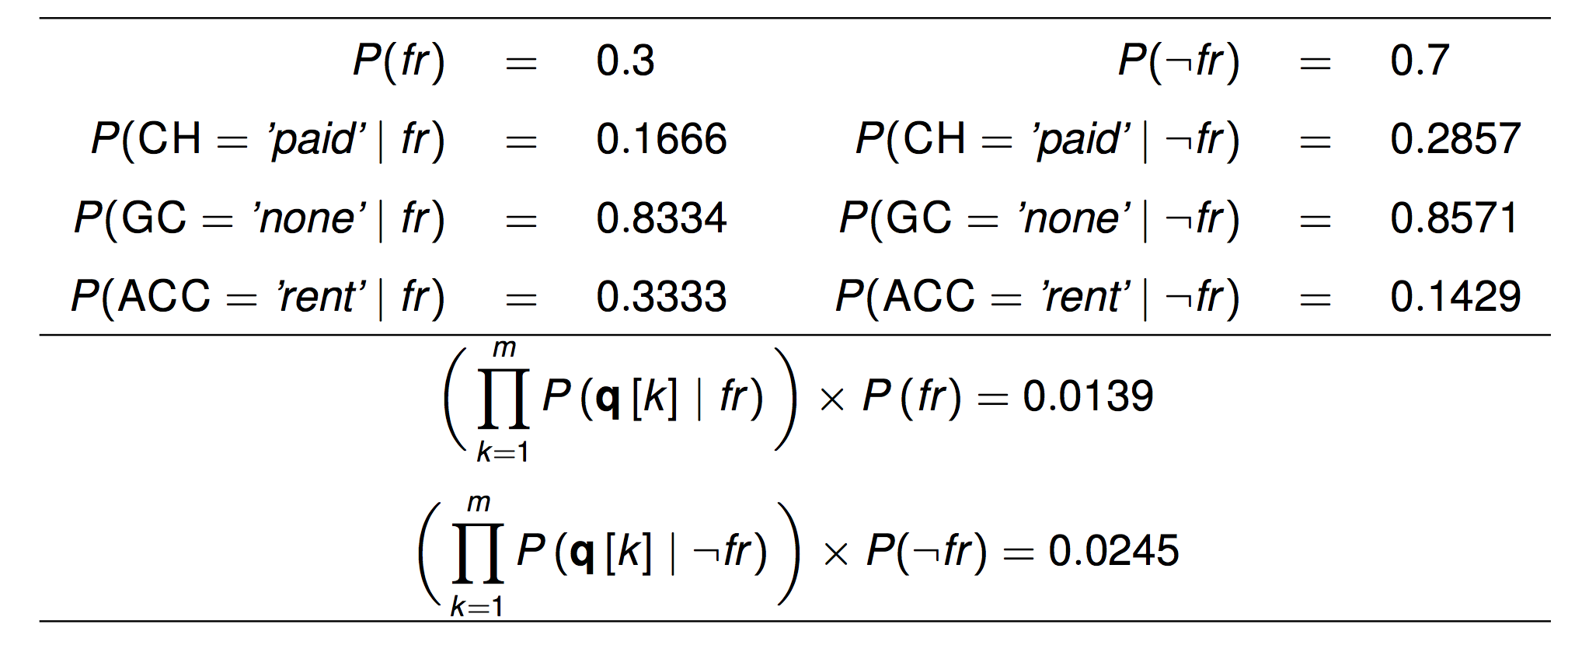

Slide 25
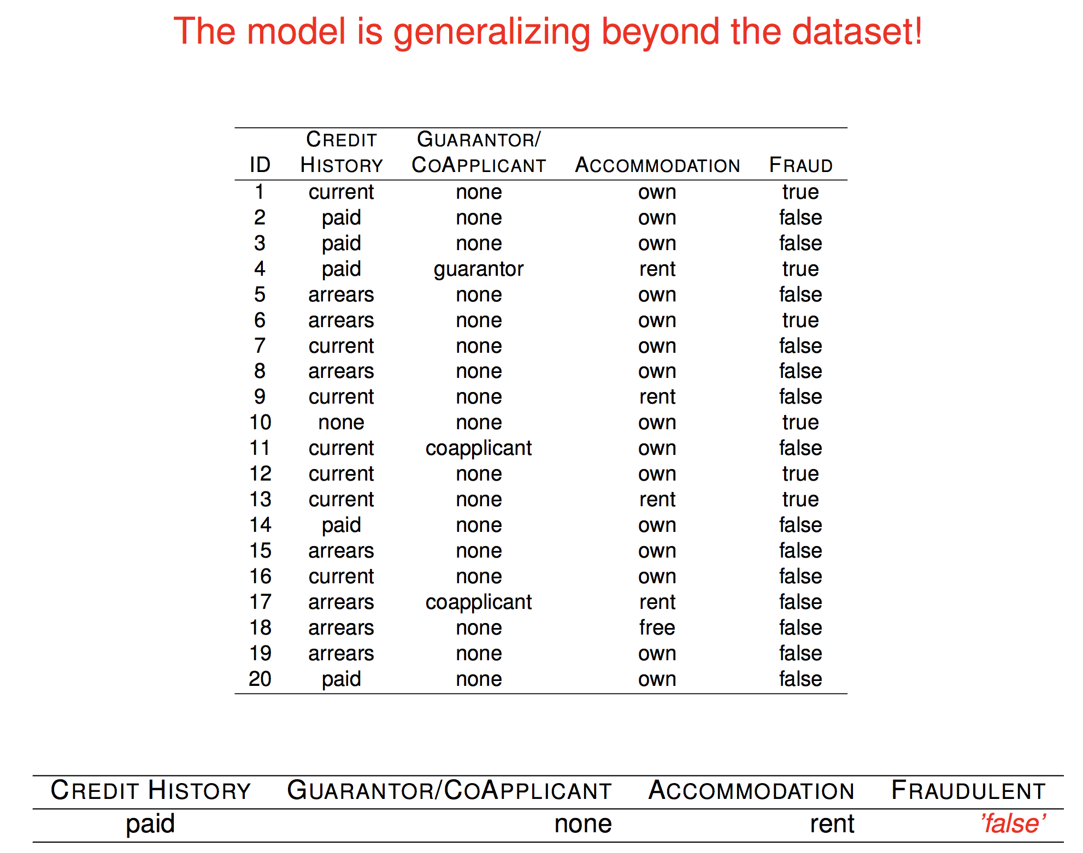

Slide 26
Short Conclusion
A Naive Bayes’ classifier naively assumes that each of the descriptive features in a domain is conditionally independent of all of the other descriptive features, given the state of the target feature.
This assumption, although often wrong, enables the Naive Bayes’ model to maximally factorize the representation that it uses of the domain.
Surprisingly, given the naivety and strength of the assumption it depends upon, a Naive Bayes’ model often performs reasonably well.

Slide 27
Smoothing

Slide 28
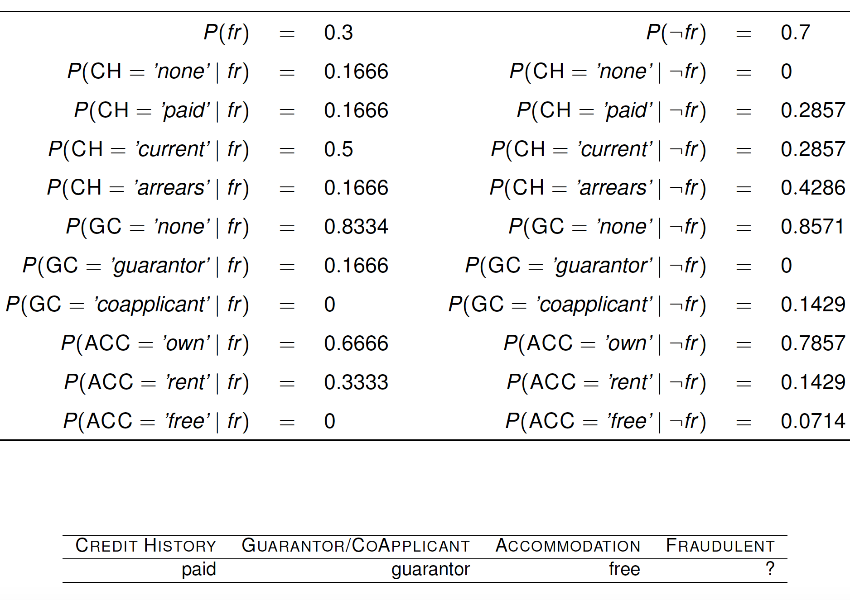

Slide 29
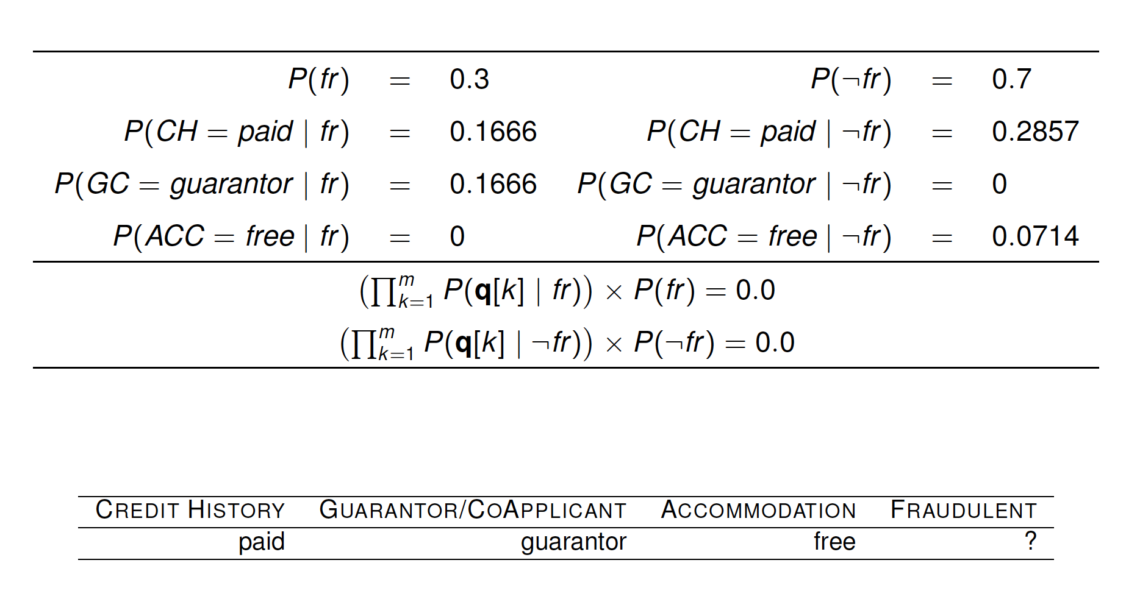

Slide 30
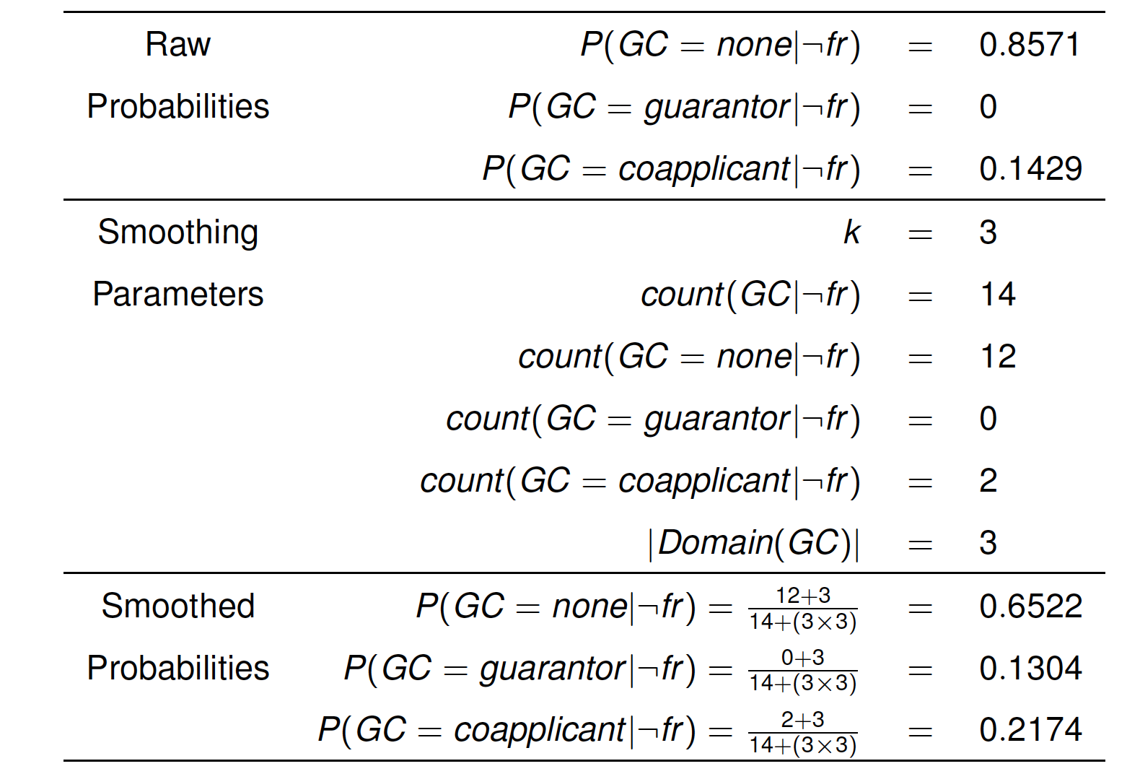
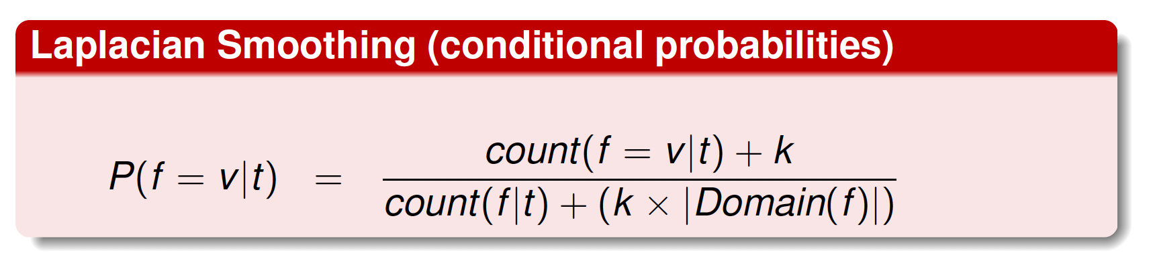

Slide 31
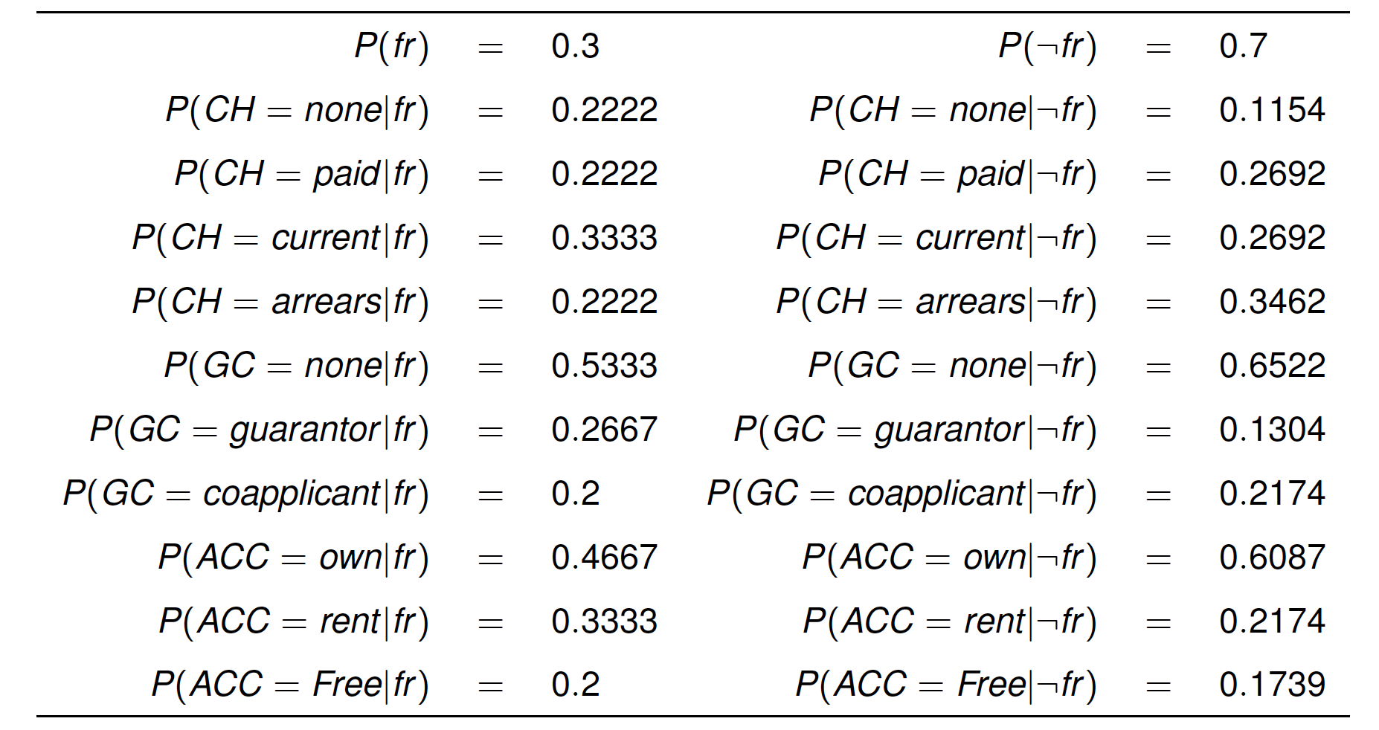
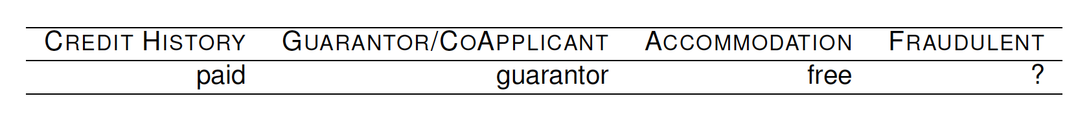
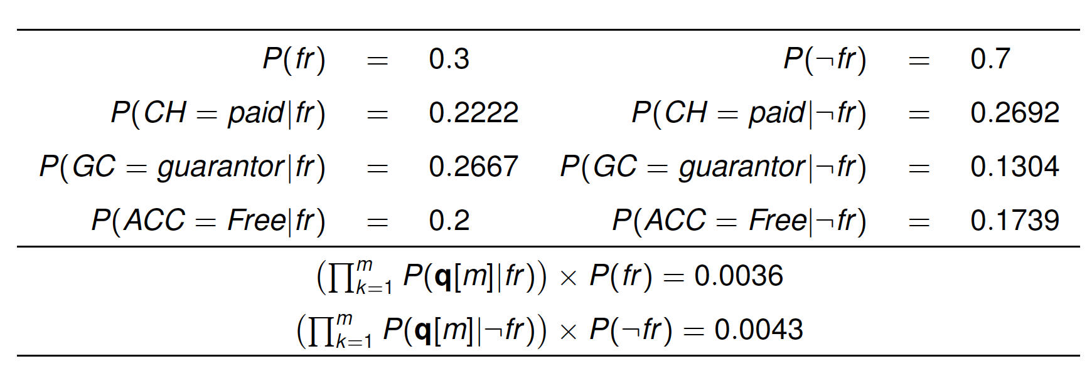

Slide 32
Continuous Feature:
Probability Density Function

Slide 33
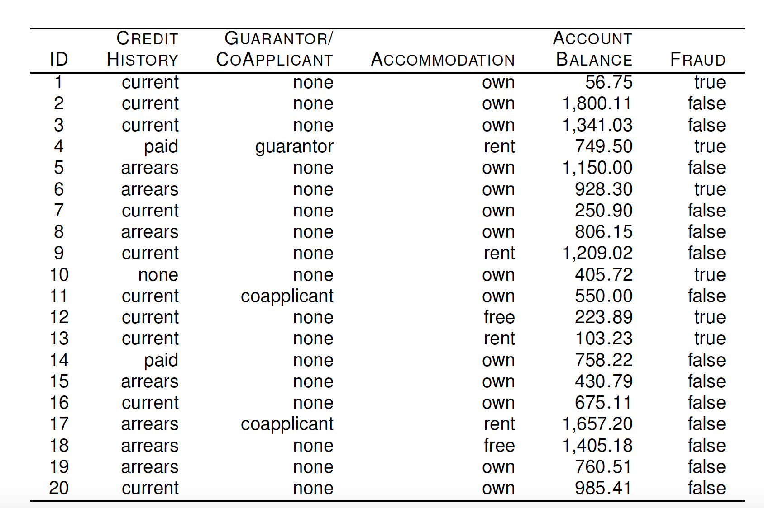

Slide 34
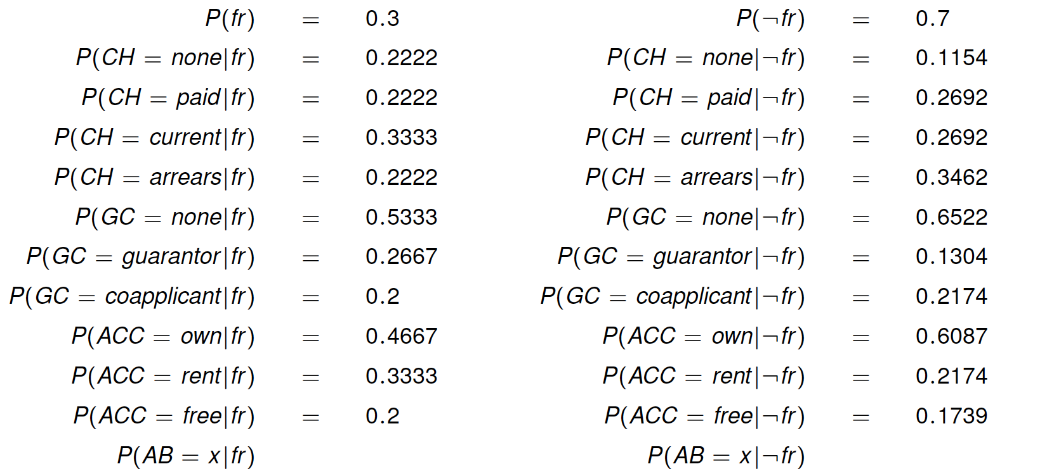
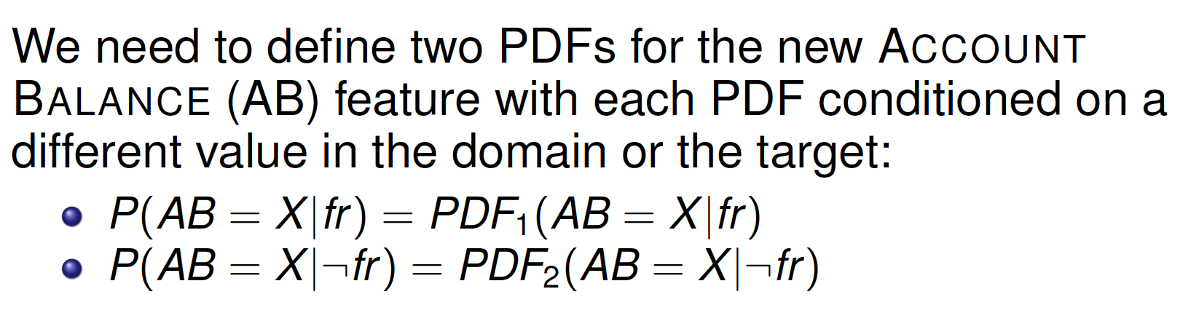
=???
=???
Use PDF: Probability Density Function

Slide 35
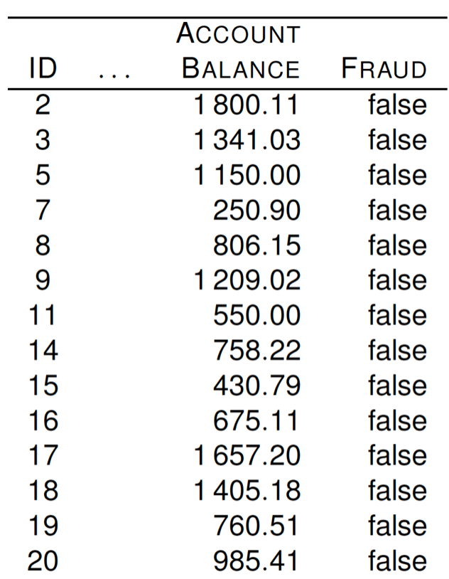






Slide 36


Slide 37





Exponential distribution

Slide 38


Slide 39


Slide 40


Slide 41


Slide 42
Continuous Features: Binning

Slide 43


Slide 44



Slide 45


Slide 46


Slide 47


